Slide 1

INTERNSHIP PROJECT ON: Twitter Sentiment Analysis
RNS INSTITUTE OF TECHNOLOGY
DEPARTMENT OF INFORMATION SCIENCE
AND ENGINEERING
Under the guidance of:
Mrs. Kusuma R
Assistant Professor
Department of ISE
A Machine Learning Project by,
Akshatha N Tirumale (1RN16IS013)

Slide 2
AGENDA
ABSTRACT
ABOUT THE COMPANY
INTRODUCTION
APPROACH
IMPEMENTATION
IMPACT
RESULTS
CONCLUSION
FUTURE ENHANCEMENT

Slide 3
ABSTRACT
Created by Jack Dorsey, Noah Glass, Biz Stone and Evan Williams in March 2006, Twitter is a microblogging and social networking service on which users post and interact with messages known as "tweets”.
Twitter users use the platform to express their views, thoughts, opinions and emotions about various things.
This worldwide platform is a social hotspot for businesses to understand their customers.
Analysis of the tweets posted by customers give businesses an insight of what people think about their product/service.
Menstrual supplies are a very important part of a woman’s life. There are several brands that sell numerous products.
This project aims at building a Machine Learning Model that tries to read and understand the tweets about a business that sells these products aimed at women.

Slide 4
About The Company
Vision Digital India in association with Imperial Group inspired to provide digital, analytical and app developing skills in the present generation to meet the corporate needs. To support Digital India initiative, Vision Digital India is offering courses like Certified Digital Marketing Course in association with Google, Certified Analytics for all in association with IBM and iOS Mobile Application Development in association with Apple.
U2USystems enables Digital Transformation and helps businesses with digital solutions to improve Productivity, Growth, Technology Enhancements and Cost Effectiveness. Being a PMI partner they have the right experience and knowledge of Project Management. Be it Digital Marketing, Project Management, Product development or design thinking they serve all areas for the Digital Future of an Organization.

Slide 5
INTRODUCTION
Menstrual flow varies with age, number of children, and levels of hormones. Many products ranging from napkins to cups are available in the market.
A number of consumer needs have to be identified, including the need to be protected and in control, comfort and convenience.
In order for businesses and manufacturers to understand what kind of product will run in the market, what customers think about their products, it is important for them to be able to get customer feedback.
One way of getting a feedback is to directly interview the customer.
A more advanced way of understanding the customer’s opinion and sentiment about the products is to analyse what they say about their product on social media platforms.
The model caters to a brand that releases a range of women sanitary products. They start a hashtag with their brand name. We fetch tweets containing this hashtag and segregate them as positive or negative.
This analysis is then used by company to understand customer sentiments and improve the product quality according to the customer needs which in turn increases their productivity and demand in the market.

Slide 6
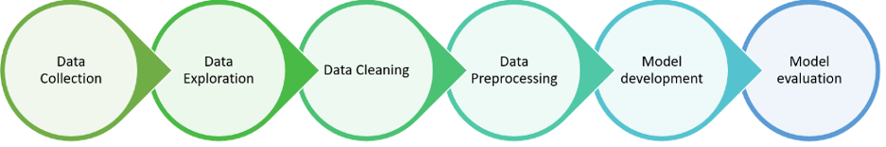
APPROACH
Understanding the Problem Statement - The objective of this task is to detect tone of speech in tweets. For the sake of simplicity, we say a tweet contains hate speech if it has negative sentiments associated with it. So, the task is to classify negative tweets from other tweets.
Tweets Preprocessing and Cleaning - Tweets contain many slang words and punctuation marks. We need to clean tweets before they can be used for training the machine learning model.
Converting Textual Data into Numeric Data – Machine Learning models cannot be fed with text data. The input should be in numerical format. The cleaned data is converted into numeric data.
Test-Train Split – The numeric data is now ready to be used in model building. First step of model building is splitting the available data into test and train data.
Model building – The train data will be used to train the model whereas the test data will be used to test the accuracy of the model.
Predict sentiment of live data – Once the model with desired accuracy is obtained, we can now use the built model to predict the sentiment of real-time data that are fetched from Twitter using API calls.

Slide 7
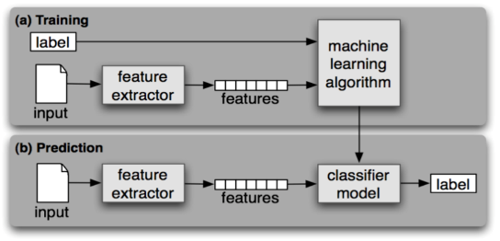
IMPLEMETATION
Training - The training data that has text and its corresponding label (positive or negative) is used to extract features and then fed into the Machine Learning Algorithm.
Prediction - Live data is obtained and its features are extracted. These features are then fed into the classifier model. The model will predict the label(positive or negative) of the live input data.

Slide 8
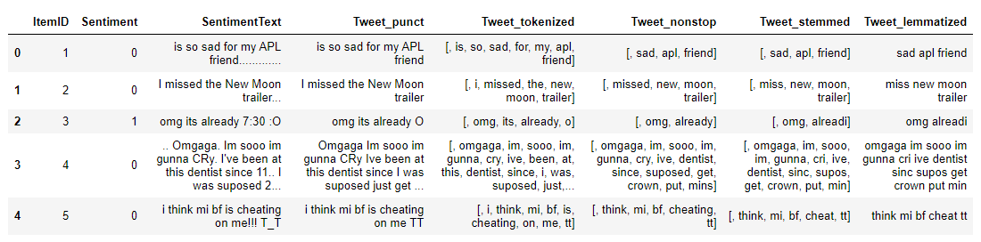
Data Preprocessing
the model building uses a supervised learning approach, the training data which is a set of tweets along with their pre-labeled sentiment – positive / negative was taken from Kaggle.
The Sentiment Text (or Tweets) have to be preprocessed in order to remove unwanted characters and words like special characters, usernames, etc.
This was done by using nltk and re packages available in Python.
There are 5 steps in data preprocessing for a textual data –
Removing punctuations
Tokenization
Removing stop-words
Stemming
Lemmatization

Slide 9
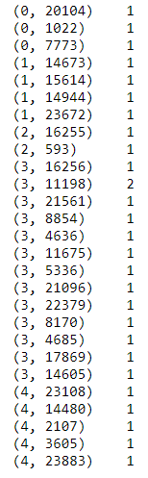
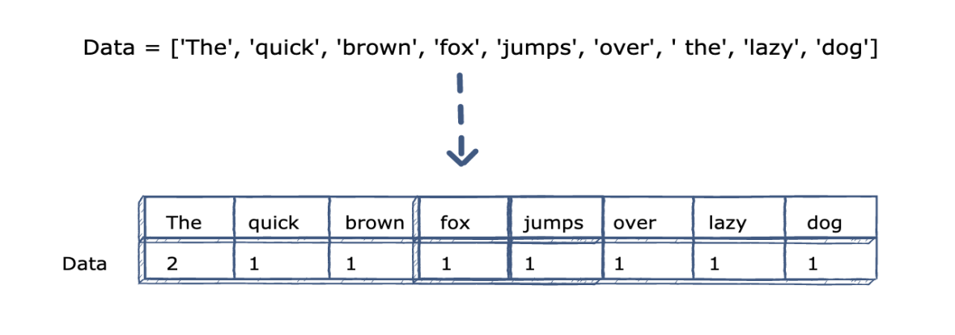
Feature Extraction
The pre-processed words need to be encoded as integers, or floating-point values, for use as inputs in machine learning algorithms. This process is called feature extraction (or vectorization).
Scikit-learn’s CountVectorizer is used to convert a collection of text documents to a vector of term/token counts.
CountVectorizer gives a matrix array of counts of all words present in the give textual data.
Most of the values in the matrix will be 0 and hence, is also called a SPARSE MATRIX.
Feature Extraction of train data

Slide 10

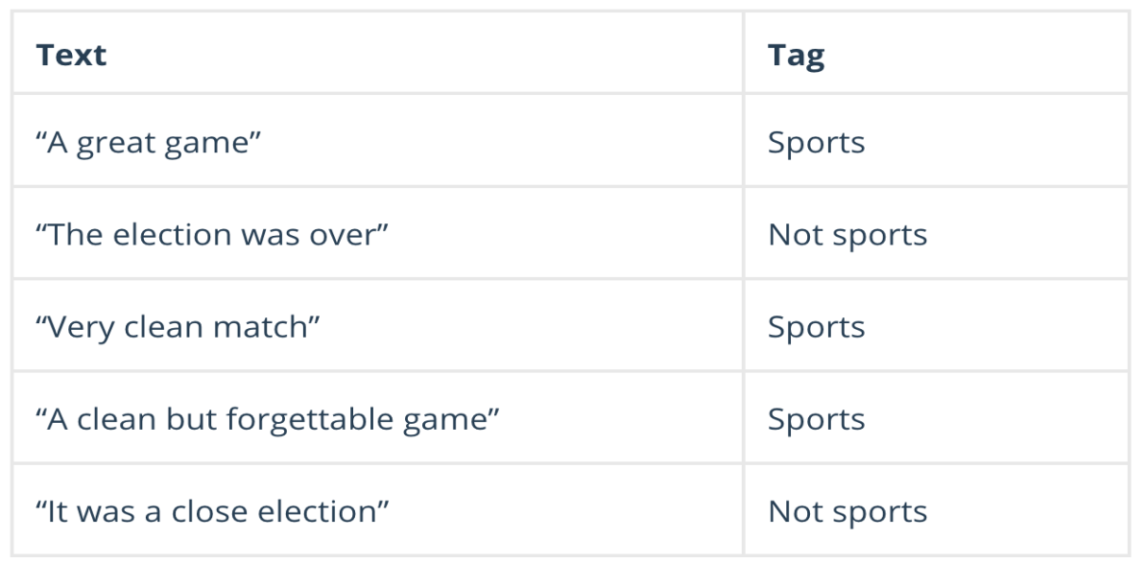
Model Building
Naive Bayes is a classification algorithm for binary (two-class) and multiclass classification problems. It is called Naive Bayes or idiot Bayes because the calculations of the probabilities for each class are simplified to make their calculations tractable.
Rather than attempting to calculate the probabilities of each attribute value, they are assumed to be conditionally independent given the class value.
MultinomialNB has been used as the classifier in this model.
Bayes Theorem finds the probability of an event occurring given the probability of another event that has already occurred. Bayes theorem is stated mathematically as the following equation:
Example:

Slide 11
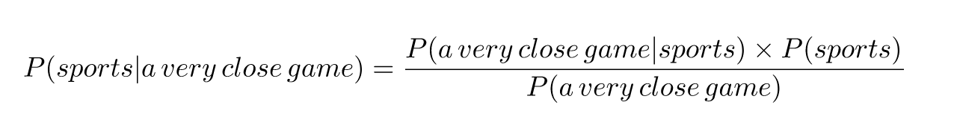
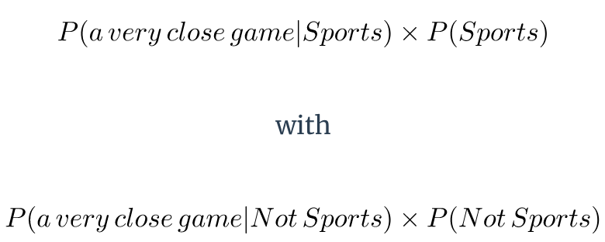
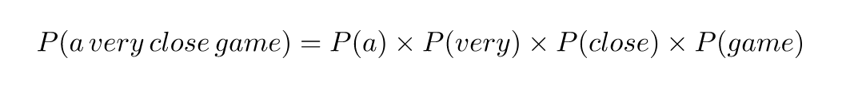
Let us consider a sentence “a very close game”
Using Naïve Bayes Theorem:
Check which has more probability:
The probability can be written as:

Slide 12
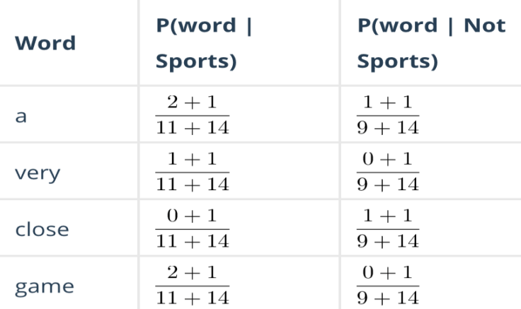
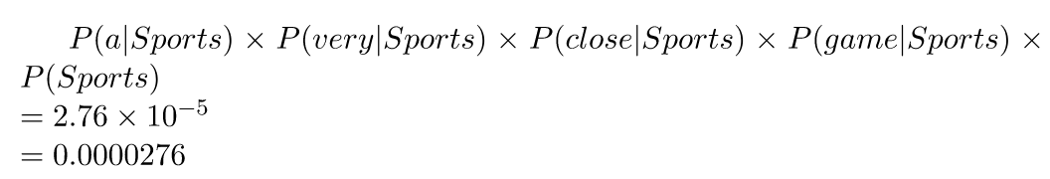
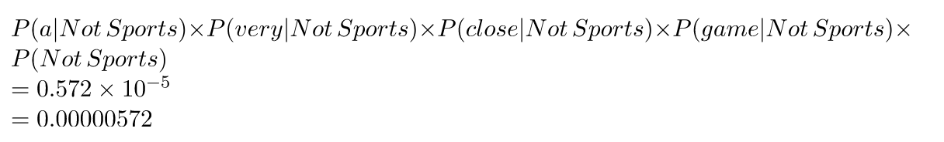
Thus the Naïve Bayes formula becomes:
Calculating probabilities:
So, we can see that the sentence will be classified as “Sports” as the probability is greater.

Slide 13
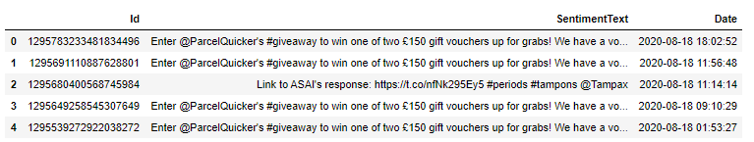
Retrieving Twitter Data
Once the model has been built, we can use it for classifying real-time data.
Tweets with a particular hashtag is retrieved using the Twitter API call.
Python package tweepy is used to place the API call.
tweepy.API.search returns a collection of relevant Tweets matching a specified query.
api.search(q=“#tampons”, count=10000, lang=‘en’) – this will return 1000 latest tweets with the string “#tampons” in them.
These tweets can then be processed and sent to the Naïve Bayes model for sentiment prediction.

Slide 14
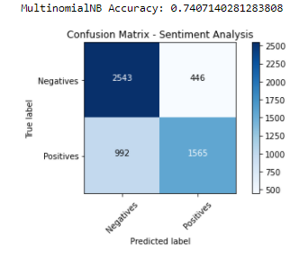
RESULTS
Confusion Matrix of model

Slide 15
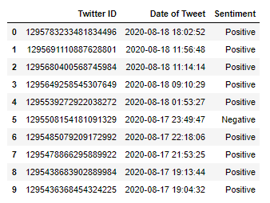
Predictions made by model.

Slide 16
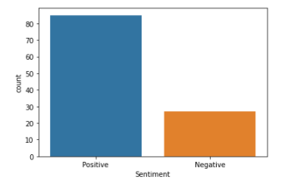
Review of positive and negative tweets.

Slide 17
IMPACT
With the rapid growth of the Internet, Consumer’s naturally gravitate to reading reviews in order to decide whether to buy a product or not! Online reputation is one of the most precious assets for brands.
A bad review on social media can be cost a company if it’s not handled properly and swiftly. After all, 80% of consumers get advise on products from social media.
This Twitter sentiment analysis allows the company to keep track of what’s being said about your product or service on social media and can help detect angry customers or negative mentions before they turn into a major crisis.
At the same time, it provides interesting insights to understand customer feedback.
On the whole, this tool can help impact a company’s customer relations in a greatly positive way thus, increasing its market demand.

Slide 18
CONCLUSION
From the results we could see that the model gave an accuracy of 74%. The Naïve Bayes classifier has done a moderately good job in classifying the tweets into positive and negative.
The model helps the company get an insight on customer feedback about their products, which would allow it to work with the sales and marketing department to come up with an efficient strategy for marketing and promotions.
It provides a statistical analysis of the products for improved customer care, quality improvement and R&D process.

Slide 19
FUTURE ENHANCEMENTS
The model can be further improved to group tweets based on sentiments like anger satisfaction, suggestions and many more.
It can be implemented in various industries from IT products to basic provisions.
The model’s accuracy can be improved to a greater extent by using other superior ML classifiers.

Slide 20
REFERENCES
https://www.analyticsvidhya.com/blog/2018/07/hands-on-sentiment-analysis-dataset-python/
https://towardsdatascience.com/another-twitter-sentiment-analysis-bb5b01ebad90
http://visiondigitalindia.com/

Slide 21
THANK YOU

